Slide 1
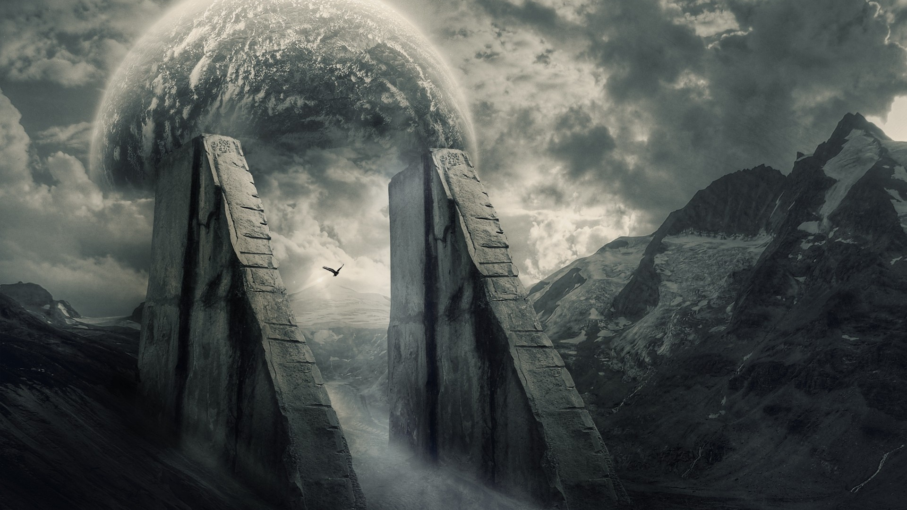
Blade of the Lost: The Silent Survivor Progress Report 3:
Developers: Josef Bacík (312553801) and Eduin Hernandez (艾德文 - 0860828)
Group #19
Instructor: 黃世強
https://wallpapersafari.com/w/Ppzkj5

Slide 2
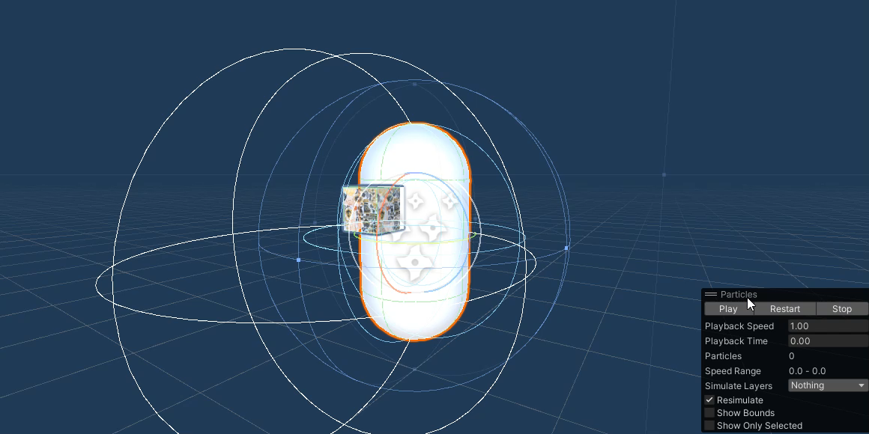
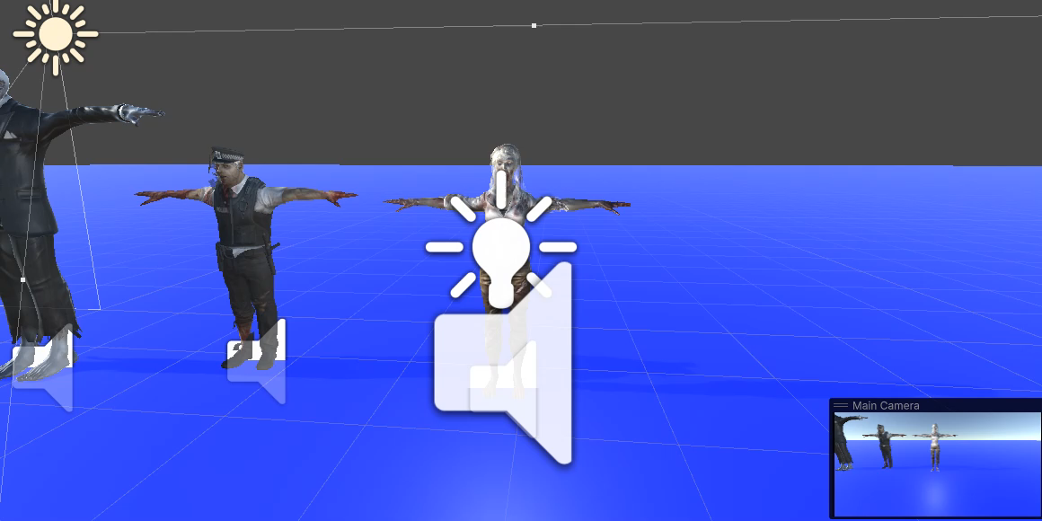
NEW ENEMY ANIMATIONS
EXPLOSION
CRAWLING
CLIMBING

Slide 3
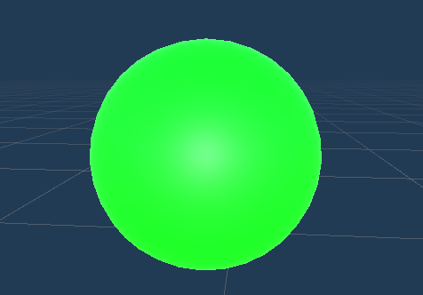
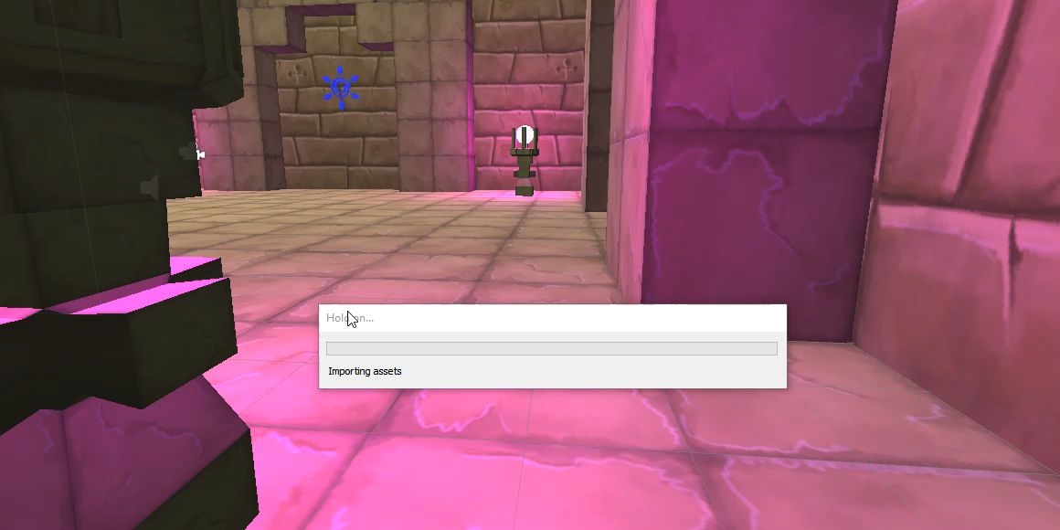
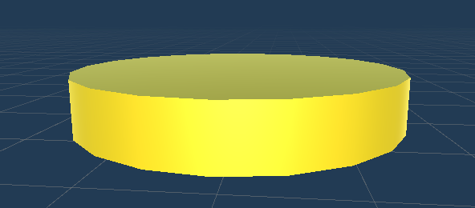
Enemy Drop Exp + COINS
EXP
COINS
*Drops spawn randomly around dead body

Slide 4
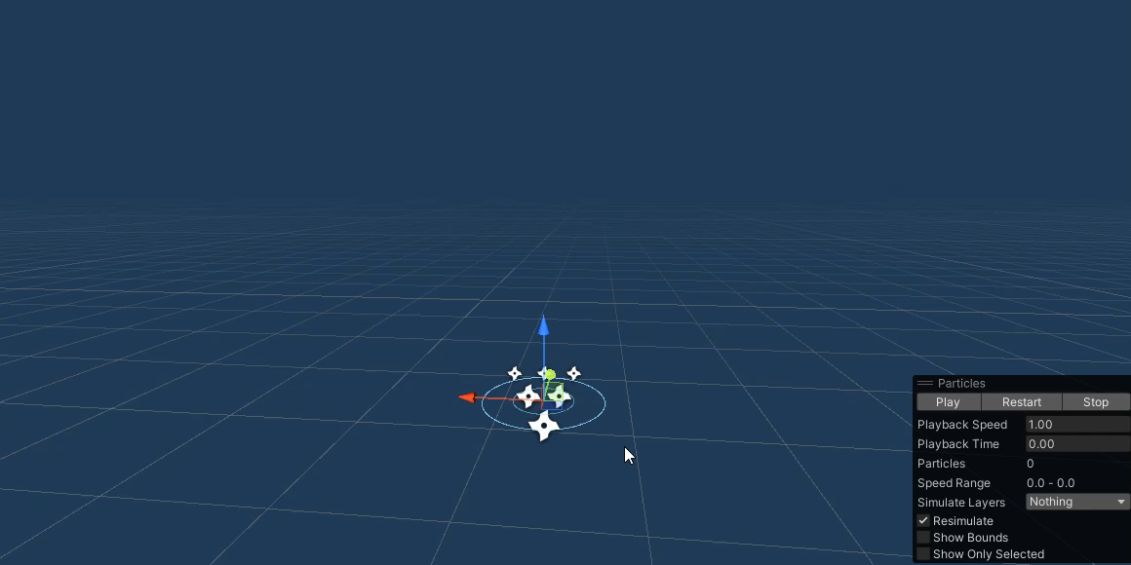
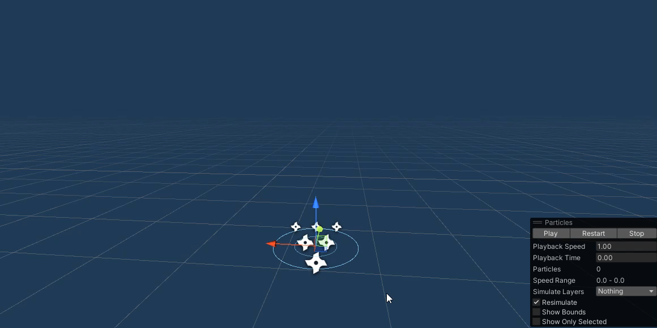
NEW ENEMY Behaviors
SPAWN AROUND THE ENEMY
WITHIN A RANGE
SAFETY RANGE
Spawn Particles

Slide 5
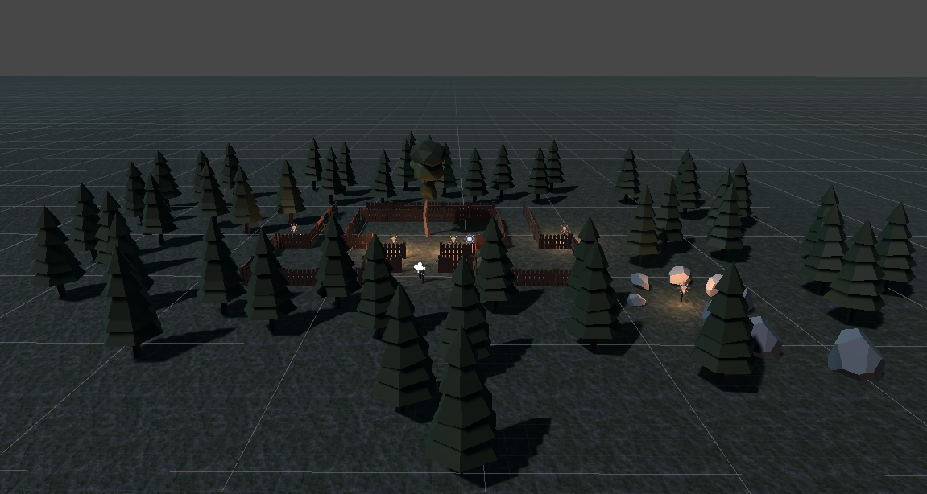
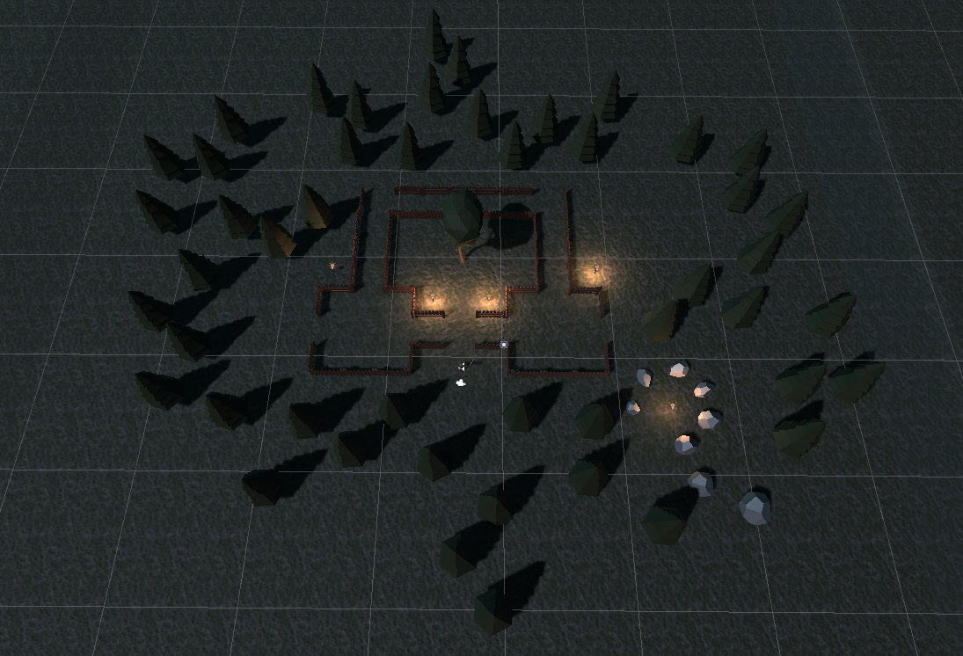
NEW SCENE: Zombie Camp
Top View
Front Side View

Slide 6
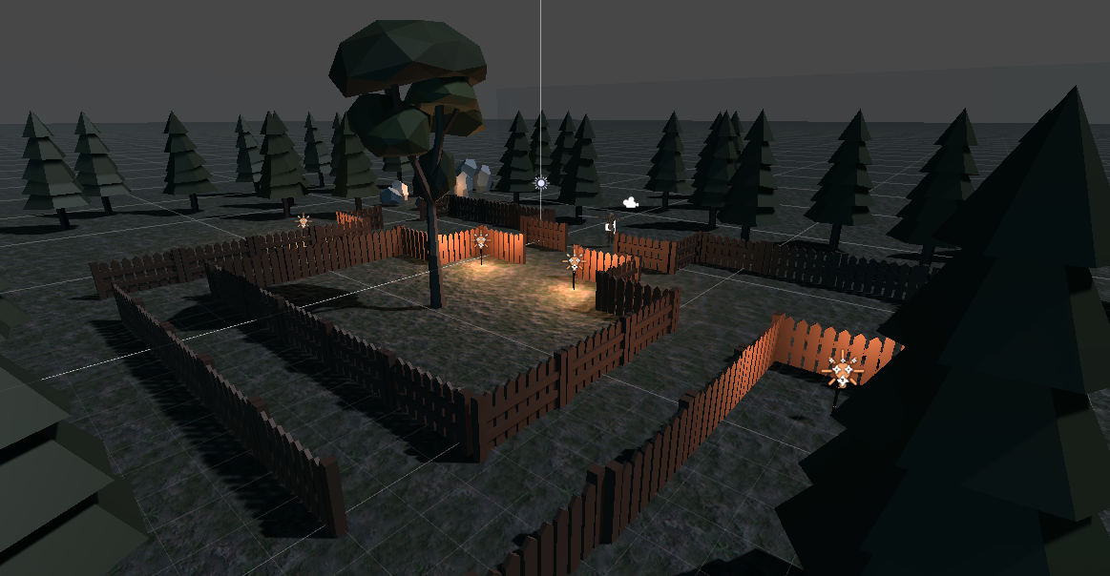
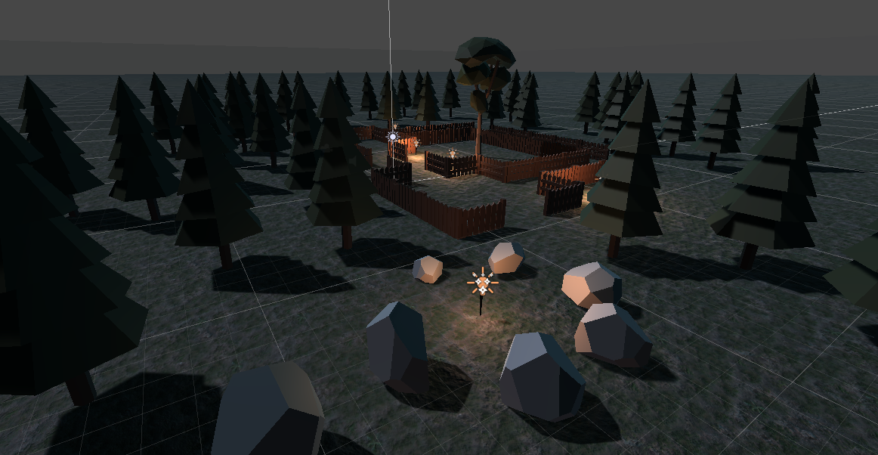
NEW SCENE: Zombie Camp
Left Side View
Back Side View

Slide 7
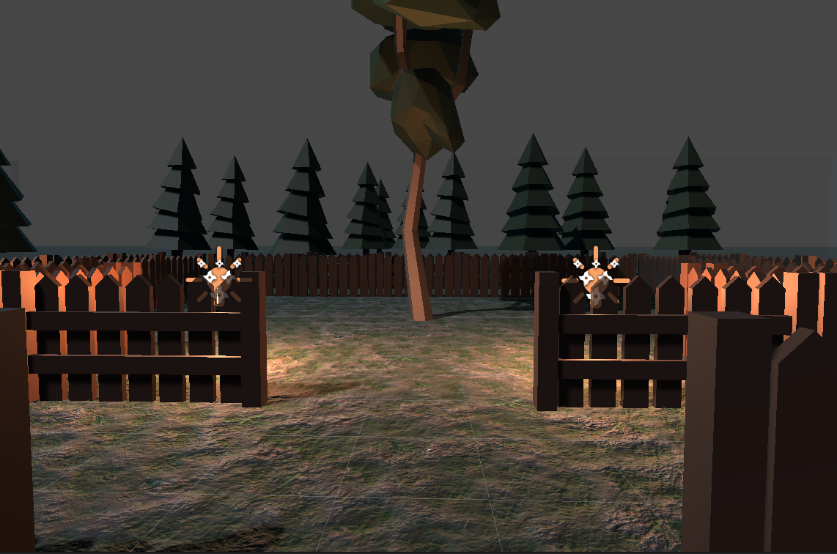
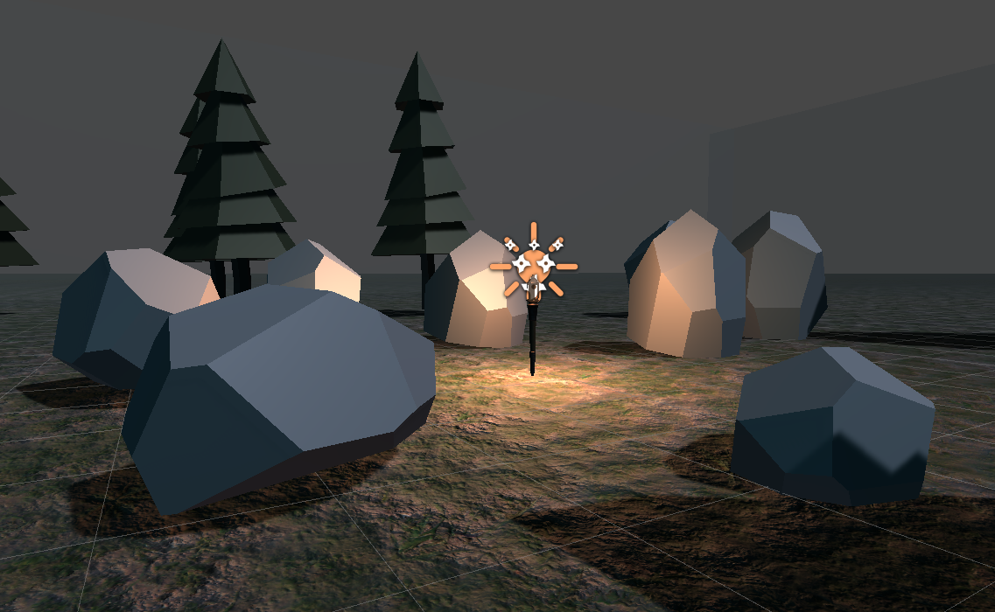
NEW SCENE: Zombie Camp
Player View - Rocks
Player View - Entrance

Slide 8
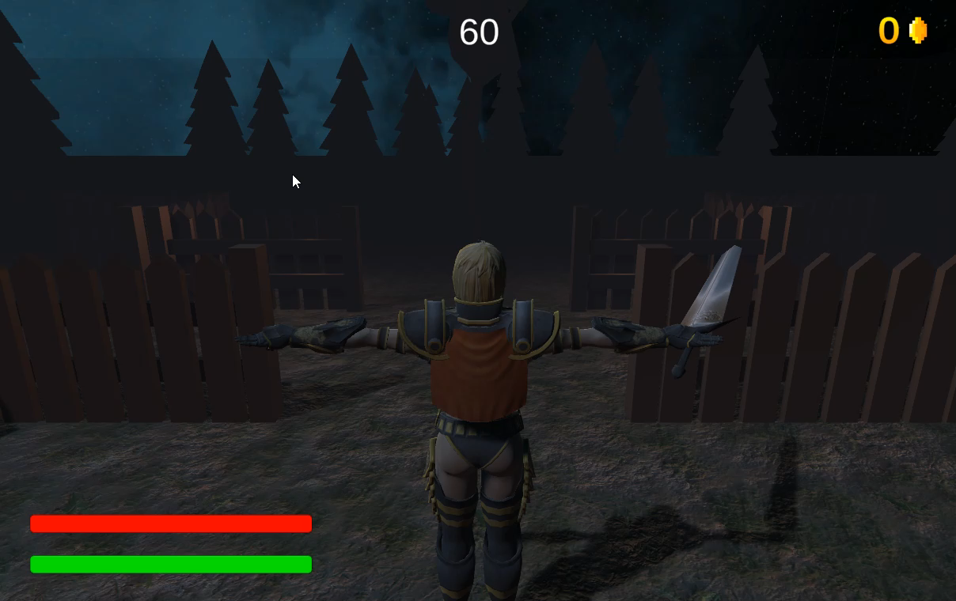
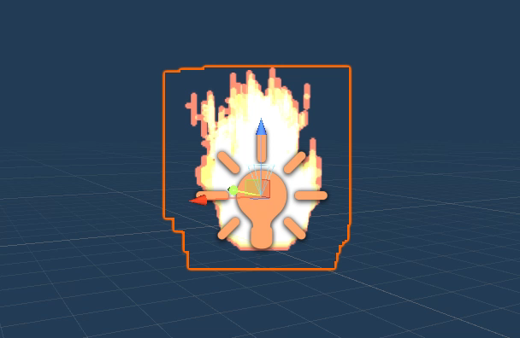
NEW SCENE: Zombie Camp
ROTATING SKY BOX
FOG
ANIMATED TORCHES

Slide 9
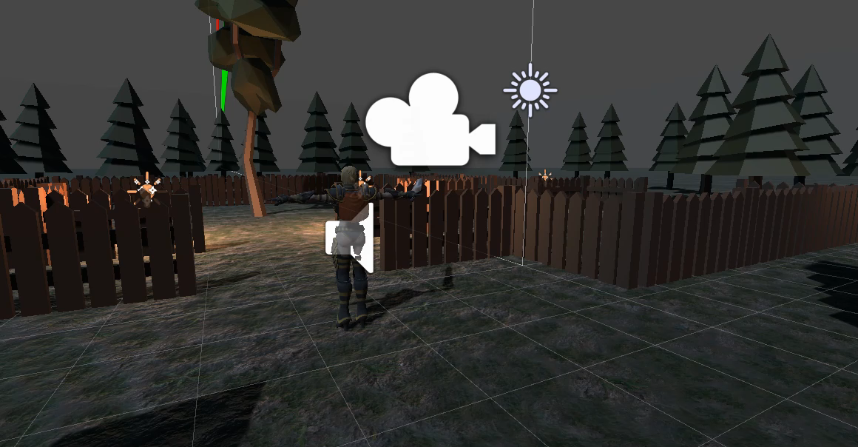
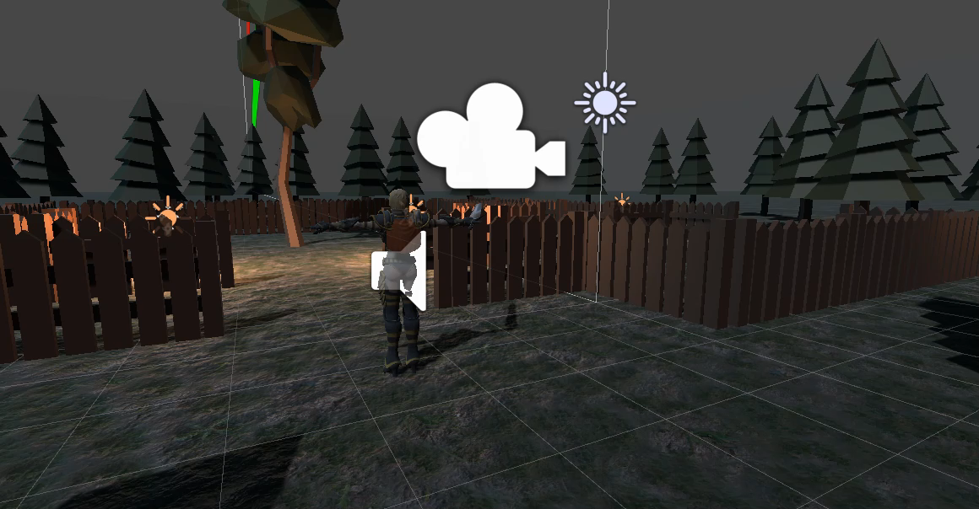
Gameplay Look

Slide 10
THANK YOU!

